Slide 1
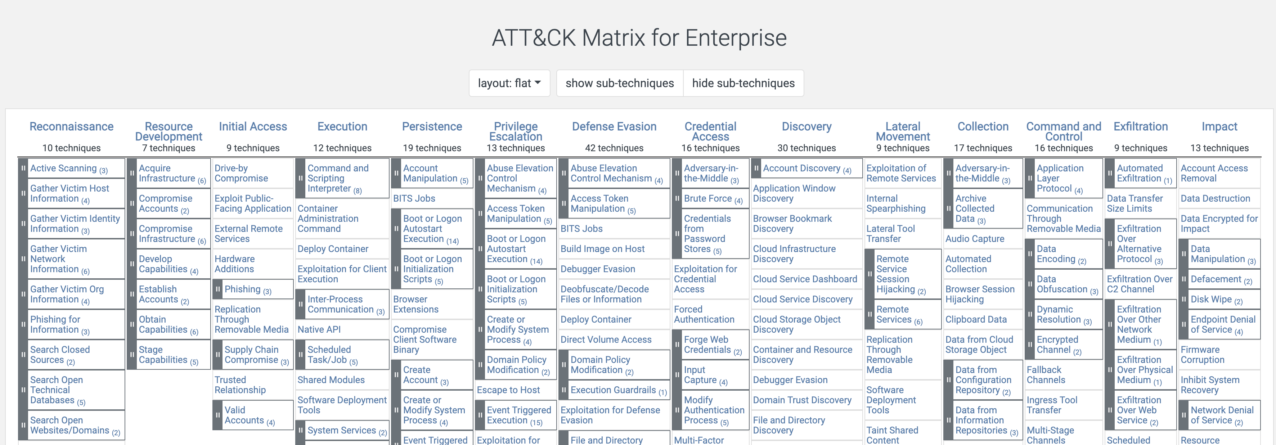
MITRE ATT&CK
https://attack.mitre.org/
Today we will be looking at Exfiltration.

Slide 2
Exfiltration

Slide 3

Data Exfiltration
What is Exfiltration?
Removing data from an environment, ideally (from the attacker perspective), without detection.
This often involves covertly staging, packaging, and transferring data.
Some examples:
See C2… often exfiltration takes place via the Command and Control communication pathway.
Cloud storage or other online resources that support file upload.
Techniques to conceal data egress may include breaking it into chunks, encrypting the data, transmitting over expected protocols or uploading to attacker-controlled accounts, with legit and expected cloud services.

